Slide 1
BEHAVIOUR ANALYSIS OF CYBER ATTACKS USING KNIME
Sahithya Bathula(180031153)
N.Sri Vyshnavi(180031168)
C.Gayathri(180030873)

Slide 2
Introduction
Malicious attacks have one thing in common – they all behave differently than normal everyday behavior within a system or network.
Companies can often identify malicious behaviors through signatures that are directly related to certain types of well-known attacks.
However, as attackers get more sophisticated, they continually develop new tactics, techniques, and procedures (TTPs) that allow them not only to enter vulnerable environments, but also to move laterally undetected.

Slide 3
What Behaviors Are Telling of Nefarious Activity?
Behavioral analysis can identify events, trends, and patterns – both current and historic – that are outside the parameters of everyday norms.
A link in a legitimate-looking file loads into memory, and then remotely loads a script to go after confidential data that is sent back to the attacker.
Malicious code is injected into already installed applications – like Microsoft Word, Flash, Adobe PDF Reader, a web browser, or JavaScript – to target vulnerabilities and then execute malicious code.

Slide 4
With the assistance of monstrous volumes of unfiltered endpoint information, security staff would now be able to utilize conduct based instruments, calculations, and AI to figure out what the typical conduct of regular clients is - and what it isn't.
Conduct examination can distinguish occasions, patterns, and examples - both current and notable - that are outside the boundaries of regular standards.
By focusing in on these peculiarities, security groups can acquire perceivability and recognize startling conduct strategies of assailants right off the bat, before they completely execute their arrangement of assault. Conduct examination can likewise assist with revealing main drivers and give experiences to future ID and forecast of comparative assaults.

Slide 5
Abstract
Cyber attack is a sensitive issue in the world of Internet security.
Governments and business organizations around the world are providing enormous effort to secure their data.
It is important to understand those attacks both before and after they happen in order to provide better security to our systems. Understanding attack models provide more insight into network vulnerability, which in turn can be used to protect the network from future attacks.
Accounts of digital assaults are turning into a daily practice in which digital aggressors show new degrees of aim by modern assaults on networks

Slide 6
Shockingly, digital lawbreakers have sorted out beneficial plans of action and they exploit the web-based secrecy. A major circumstance that necessities to improve for networks safeguards.
In this undertaking, we show that better outcomes can be gotten by performing conduct investigation on higher semantic level. We model this conduct by making altered business as usual profile of this framework and assess how well does peculiarity based discovery work in this situation.
This undertaking is a work to give an audit of significant hypotheses and standards, and gives experiences including an interdisciplinary structure that joins conduct digital protection, human factors, and demonstrating and reproduction.

Slide 7
Machine Learning for Behavioral Analysis:
On account of conduct examination and abnormality discovery, an advanced danger identification programming might utilize a blend of ML methods.
For instance, we can utilize classification in a Supervised ML calculations to recognize spam dependent on email content, Regression calculations to progressively distinguish hazard levels while utilizing a similar programming might utilize Unsupervised ML methods to identify peculiarities in information streams like organization traffic.

Slide 8
LITERATURE SURVEY
Architectural and Behavioral Analysis for Cyber Security
Review and insight on the behavioral aspects of cyber security
Using Behavioral Modeling And Customized Normalcy Profiles As Protection Against Targeted Cyber-Attacks
Behavioral Analysis of Insider Threat: A Survey

Slide 9
What is KNIME?
KNIME Analytics Platform is an open-source investigation answer for information researchers made by KNIME.com AG.
It utilizes the force of the Eclipse stage and a bunch of other incredible augmentations intended for AI and information mining to work with clients in finding expected secret information, foresee new guidelines, and mine new data.
Assuming you are a scientifically disapproved of master, then, at that point, KNIME Analytics Platform is an answer you ought to go for.
It has north of 2000 modules, a wide range of incorporated apparatuses, progressed calculations, and prepared to-send models.

Slide 10
Why KNIME?
Features:
Big Data extensions
Tool blending
Data blending
Meta-node linking
Workflow difference
Local automation
Analytics
Advantages:
Huge informational index handling
Information control
Server based execution
Deals with various clients/work processes
Open source and associated with programming dialects like Python and R for customization

Slide 11
Procedure
Applying Data Pre Processing procedures and understanding the information and afterward performing information perception.
At long last, grouping of information and further bunching it and drawing important experiences.

Slide 12
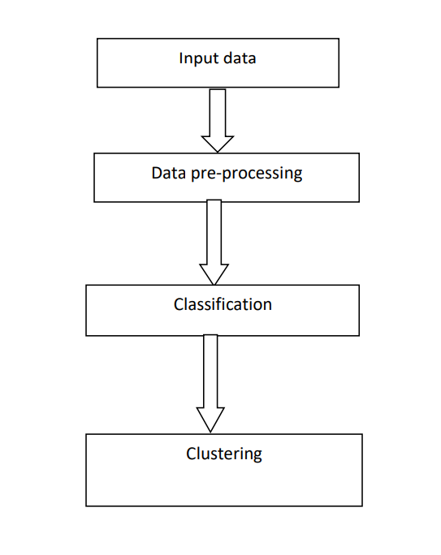
Model Diagram

Slide 13
Analysis methods used
Random Forest
Tree Ensemble
Hierarchical Clustering
K-Means Clustering

Slide 14
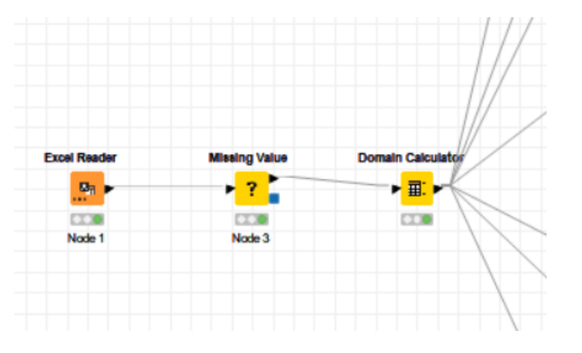
Data loading and pre-processing
In this step the data set is being loaded and cleaned and processed for further analysis to be done over it.

Slide 15
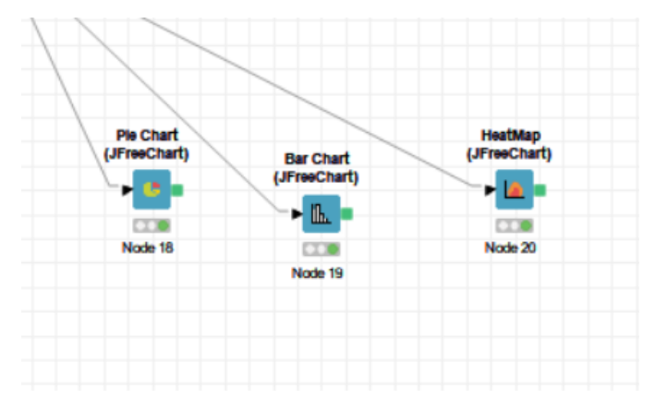
Data Visualization and Understanding of Data
In this step we are using Data Visualization techniques and representing the data as several charts and studying the data for better further analysis.
We used Pie Chart, Bar Chart and Heat Map for understanding of the various columns present in the data set (Method, Entity, Records, Year, and Organization Type).

Slide 16
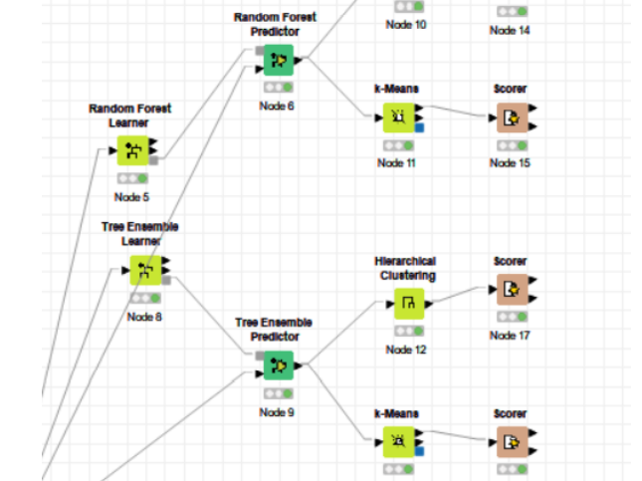
Classification and Clustering of Data
Here we are Classifying utilizing Random Forest and Tree Ensemble calculations and further Clustering the information utilizing k-implies and Hierarchical Clustering procedures and scoring our models and noticing the exactness

Slide 17
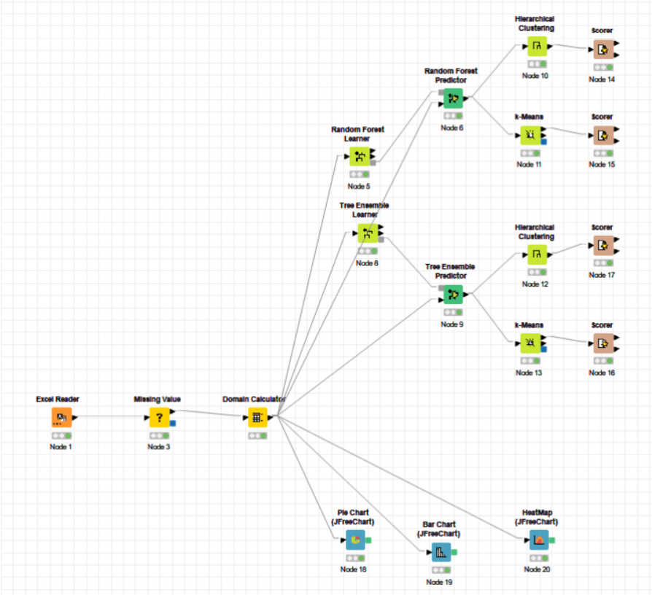
Complete Workflow

Slide 18
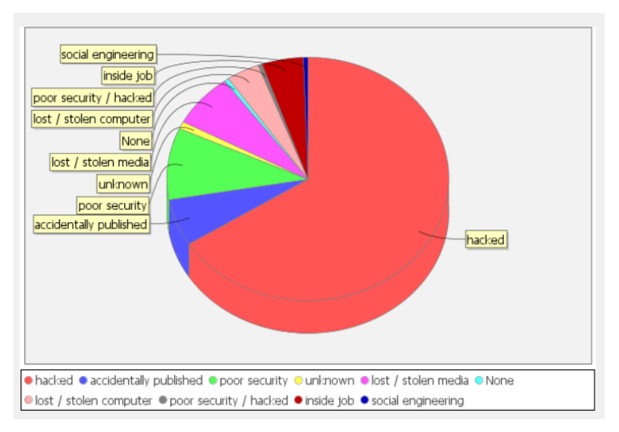
Results Data Visualization

Slide 19
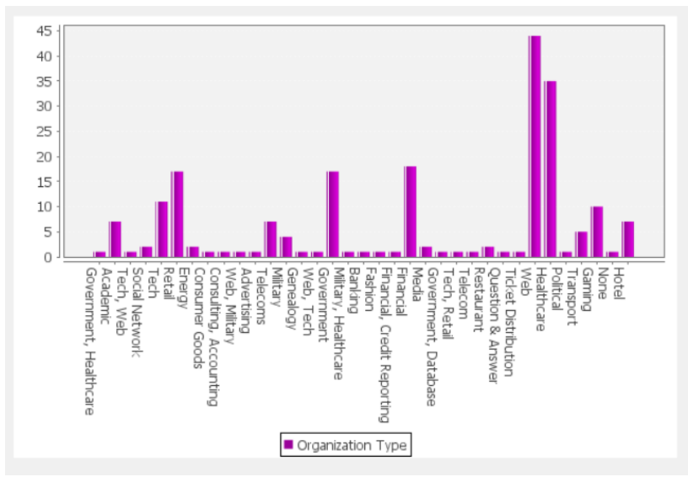

Slide 20
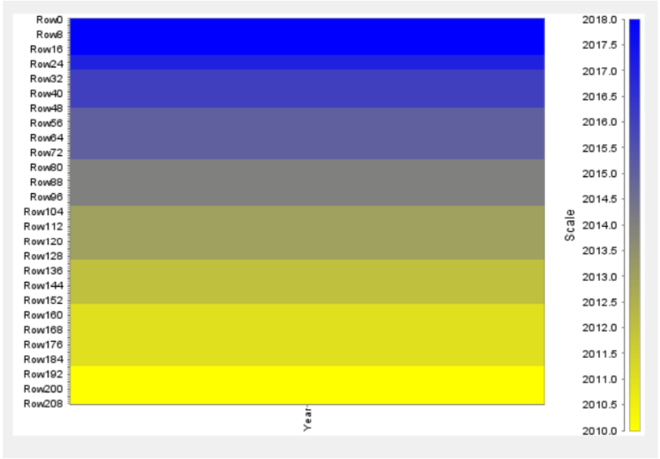

Slide 21
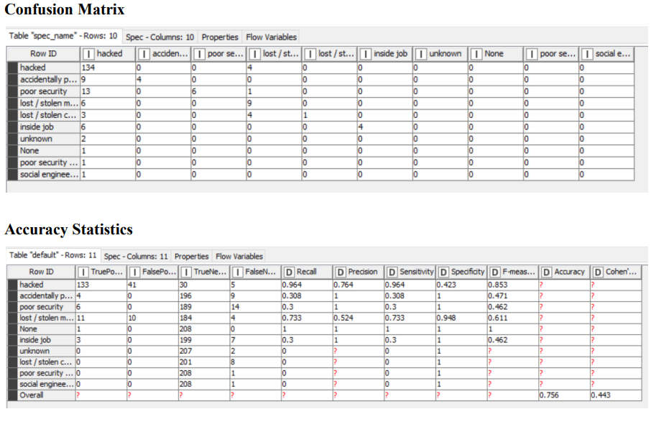
Algorithms Analysis:

Slide 22
Conclusion
Behavioral aspects of cyber security are turning into an essential region to investigate. The eccentric idea of human conduct and activities make Human a significant component and empowering influence of the degree of network safety.
The objective from talking about inspected hypotheses is to highlight significance of social conduct, climate, predispositions, discernments, discouragement, plan, demeanor, standards, options, sanctions, navigation, and so forth.
The execution of the portrayed methodology incorporates the turn of events and occasional refreshing of the predictability profile, and the on-going assignments of the usefulness extraction, recognition of known noxious functionalities, and the abnormality discovery in network activity

Slide 23
References
Citation Map
M.Golling and B.Stelte, "Requirements for a future ews-cyber defense in the internet of the future", Cyber conflict (ICCC) 2011 3rd international conference on., pp. 1-16, 2011.
"Attack models with bsimm frameworks", BSIMM, 2016, [online] Available: https://www.bsimm.com/framework/intelligence/attack-models/.
"Cbest intelligence-led testing-an introduction to cyber threat modelling", B. of England, 2016, [online] Available: http://www.bankofengland.co.uk/anintroductiontocbest.pdf.

